Slide 1

Myostatin and insulin-like growth factor-I and –II expression in the muslce of rats exposed to the mircogravity environment of the NeuroLab space shuttle flight
R Lalani, S Bhasin, F Byhower, R Tarnuzzer1, M Grant1, R Shen, S Asa2, S Ezzat2 and N F Gonzalez-Cadavid (2000)
Presented by: Fady Khalil
Collaborations:
Division of Endocrinology, Metabolism, and Molecular Medicine, Charles R Drew University, Los Angeles, California, USA
Division of Endocrinology, University of Florida, Gainesville, Florida, USA
Division of Medicine, University of Toronto, Toronto, Canada

Slide 2
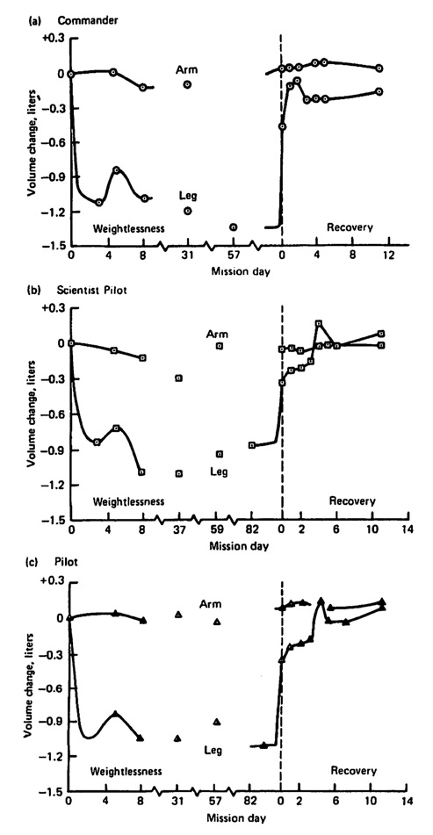
Introduction
Why is skeletal muscle mass lost during space flight?
1. Increase in protein degradation reflected by a stimulation of the ubiquitin/proteasome pathway
2. Reduction in muscle building hormones such as testosterone and growth hormone levels
3. Increased glucocorticoid levels
(Thornton, WE. Et al. 1997)
Notes:
Reference:

Slide 3
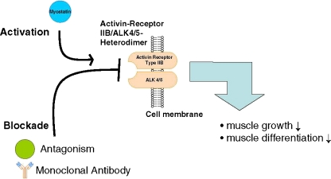
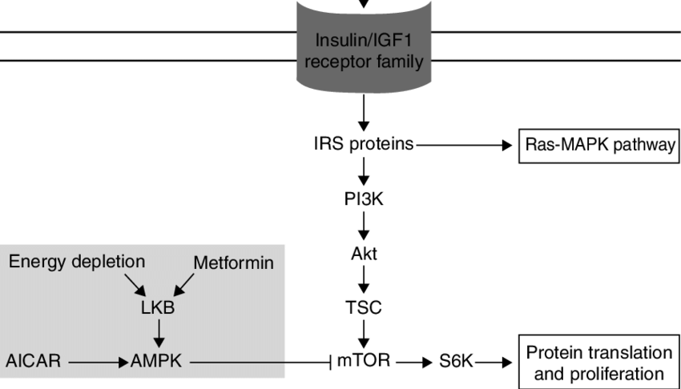
Introduction
IGF-1 and IGF-2 enhance skeletal muscle mass
Myostatin negatively regulates muscle mass
Spaceflight causes disturbances in IGF-1 and 2 production

Slide 4
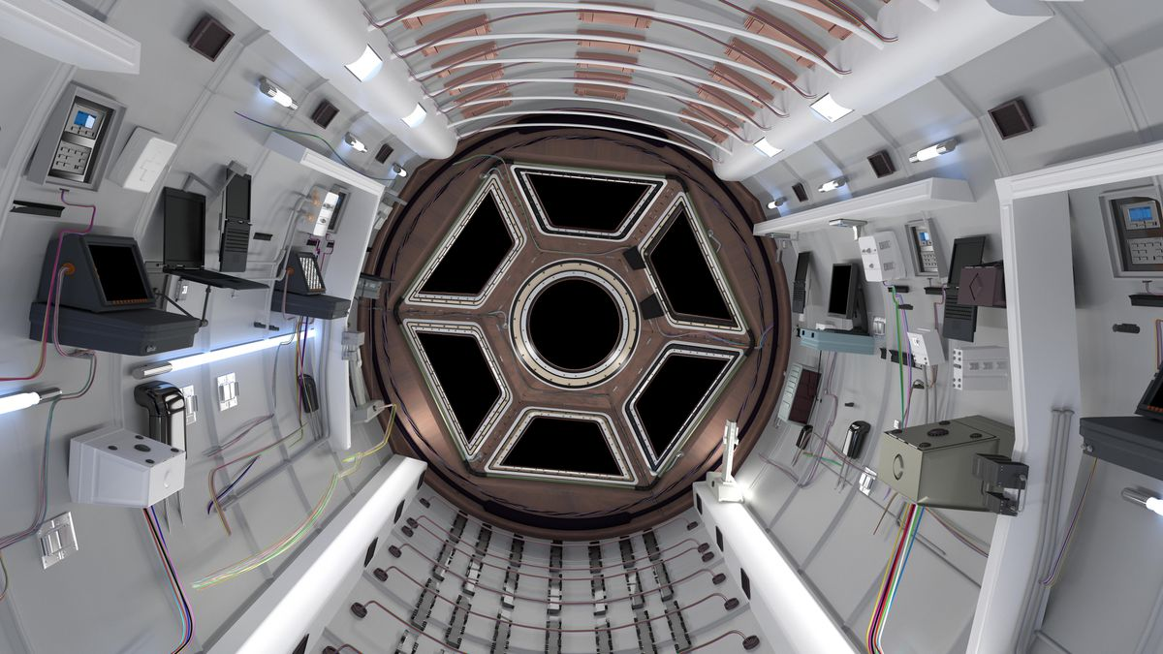
Purpose
To investigate the effects of spaceflight or microgravitational environment on the expression of myostatin and insulin-like growth factors 1 and 2

Slide 5
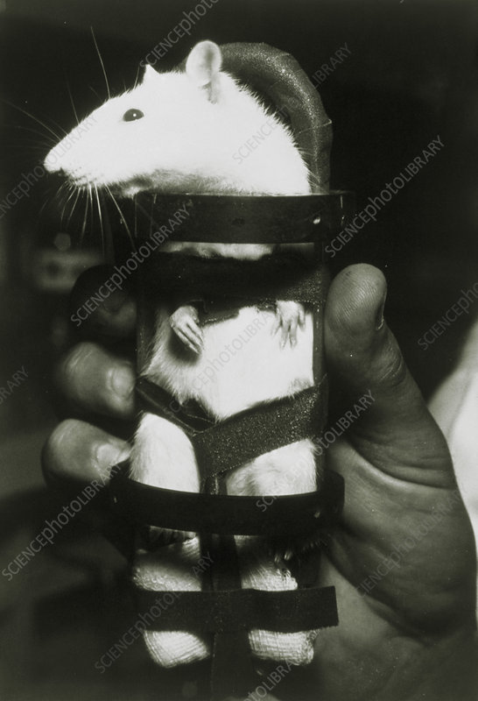
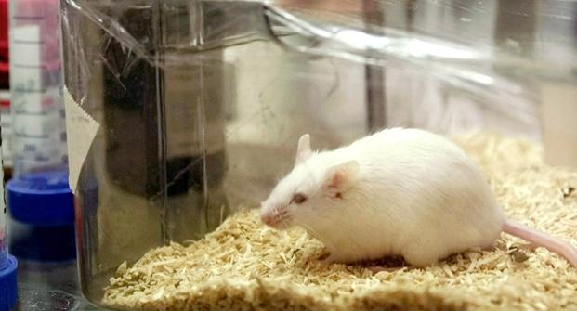
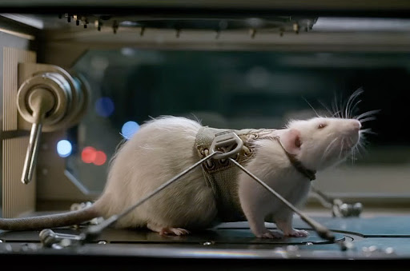
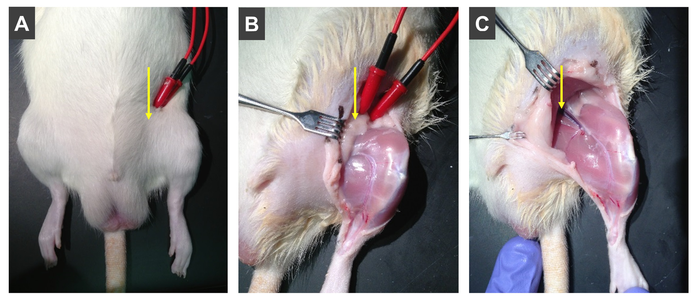
Methods
Microgravity Non-acclimated Rats (R1)
Control Groups (R3, R5, R15, R17)
Microgravity Acclimated Rats (R13)
Animals wieghed and sacrificed at certain times.
Subjected to light- dark cycles for 53 days
Dissections were taken from the skeletal muscle hindlegs.
Isolated tissue from each limb

Slide 6
Methods
Estimation of myostatin mRNA
Trizol reagent
Agarose gel electrophoresis and ethidium bromide staining (for quality)
Myostatin, B-actin, and GADPH DNA were assessed
Northern blot hybridization used to analyze the expression of different mRNA
Estimation of IGF-I and IGF-II mRNA
RT-PCR, And cDNA obtained using oligo(dT)-primed reverse transcription
Scion Image software
Validation of myostatin antibody and immunohistochemistry
Aliquots protein extraction
Immunodetection using Antibody B
Western blotting to analyze different proteins
Immunohistochemical detection
Proteolysis and apoptosis markers
HPLC amino acid analysis
Hybridization of Northern blots to determine ubiquitin mRNA
RT-PCR to determine proteasome mRNA
TUNEL method to determine apoptotic index

Slide 7
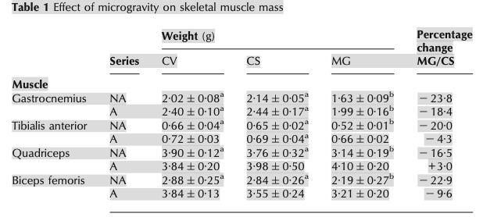
Effect of spaceflight on body weight and skeletal muscle mass
Results
Rats exposed to microgravity during spaceflight lost significant muscle mass in the studied muscle groups
13 days of acclimatization, the weights of the four muscle groups from space flight rats were not significant from control rats
However, spaceflight rats had overall less weight after the acclimatization process

Slide 8
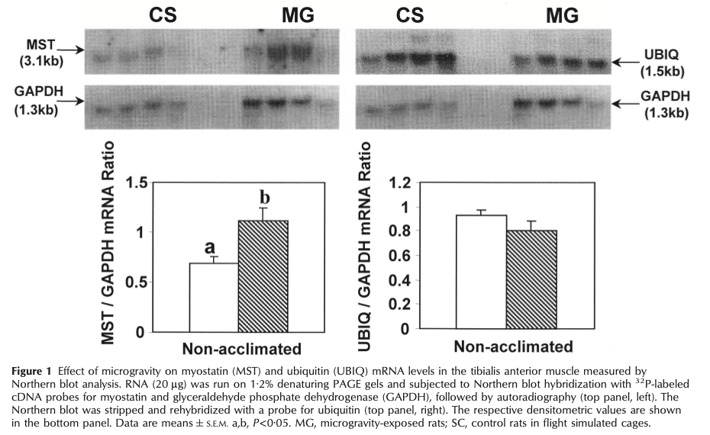
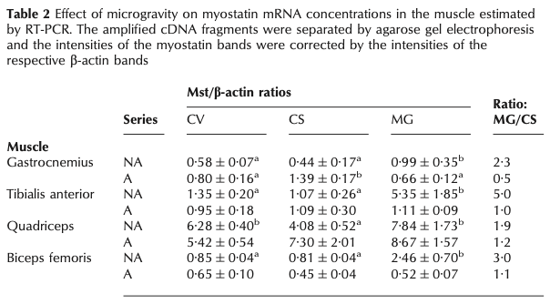
Results: Intramuscular myostatin mRNA concentrations
Mean myostatin mRNA concentrations were significantly higher in the hindlimbs muscles studied IJ spaceflight rats
After 13 days of acclimatization, myostatin mRNA concentrations returned to normal in 3 groups of space flight rats
Northern blotting used to determine the myostatin mRNA concentrations of anterior tibialis (Figure 1)

Slide 9
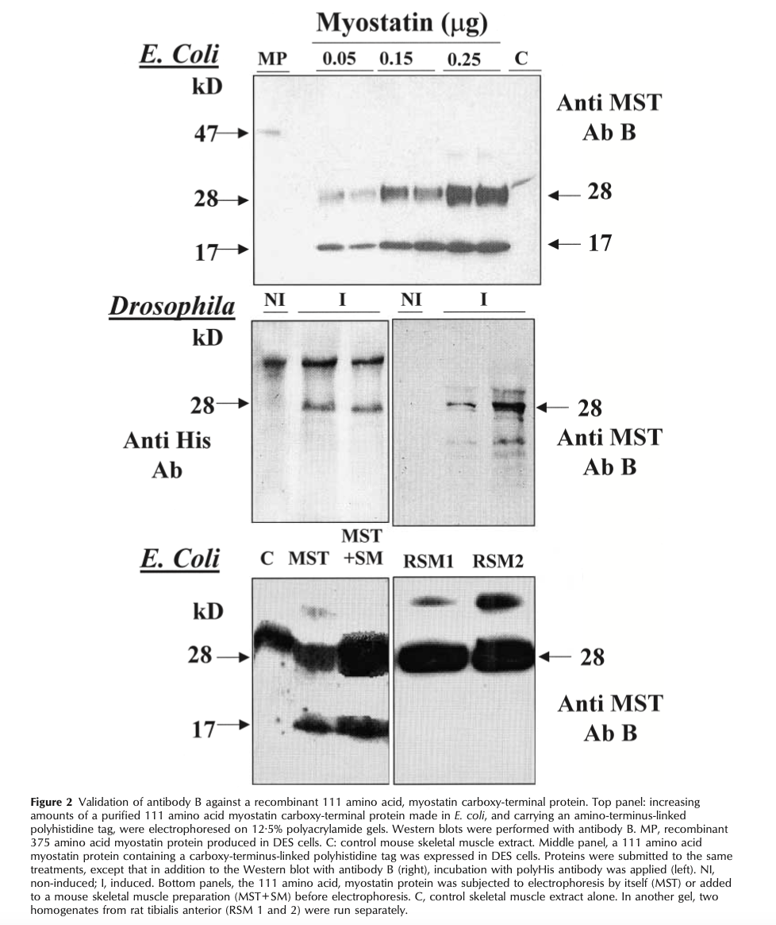
Results: Myostatin-Immunoreactive protein concentrations in the skeletal muscle assessed by immunohistochemical staining
Western blots used to detect myostatin protein
Antibody B detected the myostatin protein in E.coli

Slide 10
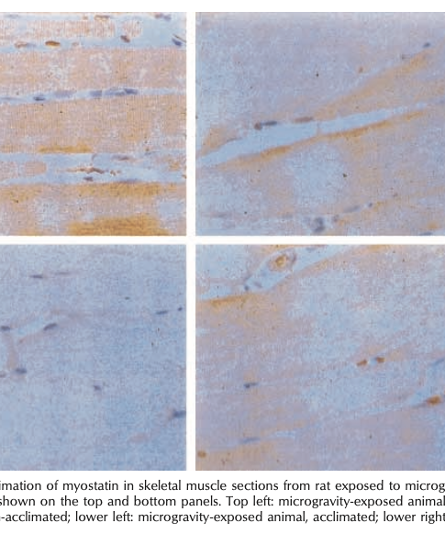
Results: Myostatin-Immunoreactive protein concentrations in the skeletal muscle assessed by immunohistochemical staining
Immunoreactivity was more intense in spaceflight rats during muscle stimulation
Immunostaining weakened after 13 days of acclimatization
Notes:
-antibody B applied to tissue sections form the tibilais anterior
- A semi-quantitative assessment based on visual inspection of three to four adjacent sections per muscle specimen with multiple observations to cover the entire field, and grading from 0 to 4 +, demonstrated a significant increase in myostatin immunoreactivity in four non- acclimated microgravity-exposed animals compared with the corresponding four simulated controls

Slide 11
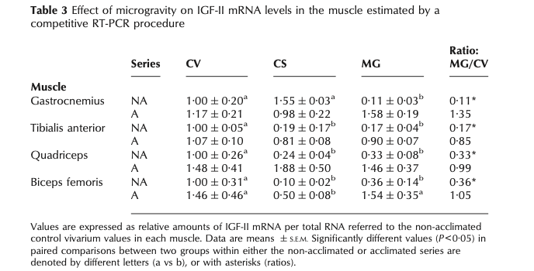
Muscle IGF-I and -II mRNA Concentrations
Results
IGF-I displayed no significant difference between groups
IGF-II was lower in all muscles studied of non-acclimatization space rat groups
IGF-II mRNA concentrations returned to normal following 13 days of acclimatization
RT-PCR procedure to measure mRNA

Slide 12
Markers of Protein Breakdown
Results
Ubiquitin mRNA transcripts were not significant between groups
No difference in proteasome 2C mRNA concentrations (data not shown)
Methylhistidine and Anserine concentrations show no significant difference
Apoptotic index did not exhibit any measurable difference (data not shown)

Slide 13
Disscusion
Loss of skeletal muscle mass due to spaceflight can be attributed to :
Increase in the intramuscluar myostatin mRNA concentrations
Decrease in IGF-II mRNA concentrations
Gene expression and weight were normalized after acclimatization at ground level

Slide 14

Concluding Remarks
Myostatin inhabition due to a mutation in cattle resulted in skeletal muslce hypertrophy (Kambadur et al. 1997, McPherron et al. 1997, McPherron & Lee 1997, Grobet et al. 1998, Szabo et al. 1998)
This is consistent with the the findings of the study and postulates that myostatin is an inhibitor of skeletal muscle growth in adult animals
IGF-II is an important regulator of muscle mass in rats
Skeletal muscle loss during spaceflight might be the result of inhibtion of protein synthesis

Slide 15
Constraints
Due to the cross-sectional nature of the study and tissue sampling obtained only at the time point after landing, it is difficult to come to a conclusion
Small sample size leading to less significant detection

Slide 16
References
Apoptosis: a mechanism contributing to remodeling of skeletal muscle in response to hindlimb unweighting D. L. Allen, J. K. Linderman, R. R. Roy, A. J. Bigbee, R. E. Grindeland, V. Mukku, and V. R. Edgerton American Journal of Physiology-Cell Physiology 1997 273:2, C579-C587
BALDWIN, KENNETH. "Effect of spaceflight on the functional, biochemical, and metabolic properties of skeletal muscle." Medicine & Science in Sports & Exercise 28.8 (1996): 983-987. Journals@Ovid Full Text. Web. 04 February. 2021. <http://ovidsp.ovid.com/ovidweb.cgi?T=JS&PAGE=reference&D=ovftb&NEWS=N&AN=00005768-199608000-00008>.
Husmann, Irene, et al. “Growth Factors in Skeletal Muscle Regeneration.” Cytokine & Growth Factor Reviews, vol. 7, no. 3, Oct. 1996, pp. 249–258, doi:10.1016/S1359-6101(96)00029-9.
Kambadur R, Sharma M, Smith T & Bass J 1997 Mutations in myostatin(GDF8) in double-muscled Belgian Blue and Piedmontese cattle. Genome Research 7 910–915.
Microgravity-induced transformations of myosin isoforms and contractile properties of skeletal muscle. V. J. Caiozzo, F. Haddad, M. J. Baker, R. E. Herrick, N. Prietto, and K. M. Baldwin. Journal of Applied Physiology 1996 81:1, 123-132
McPherron, A C, and S J Lee. “Double muscling in cattle due to mutations in the myostatin gene.” Proceedings of the National Academy of Sciences of the United States of America vol. 94,23 (1997): 12457-61. doi:10.1073/pnas.94.23.12457
Thornton, WE; Hoffler, GW; Rummel, JA (1977). "Anthropomorphic changes and fluid shifts". In Johnston, RS; Dietlein, LF (eds.). Biomedical Results of Skylab. Washington, DC: NASA. pp. 330–338.

